Slide 1

Copper creek sewer interceptor relocation
Opw 53698
September 15, 2023

Slide 2
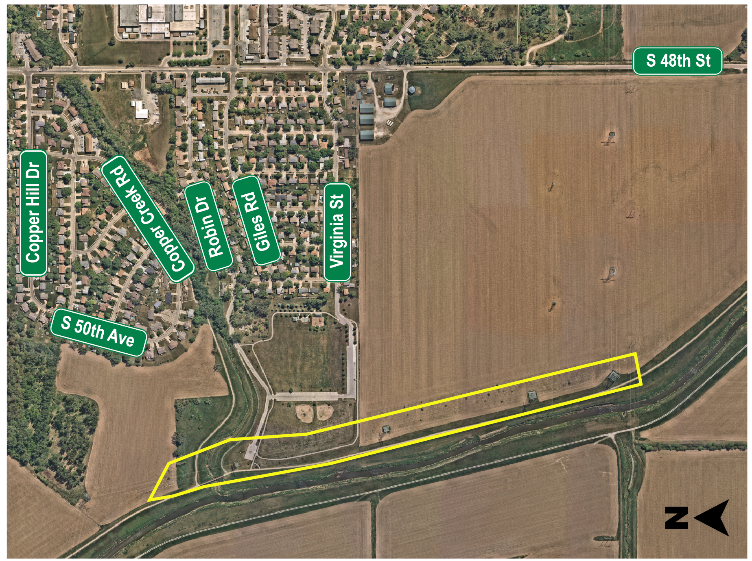
Project Location
The project will relocate the existing interceptor, which includes the aerial pipe crossing over Copper Creek and connect back into the existing system.

Slide 3
POTENTIAL impacts
The project will impact four property owners:
  Papio-Missouri River NRD, the City of Bellevue, and two farmlands.
  The City of Omaha began communication with property owners in April 2020.

Slide 4
POTENTIAL impacts
The project will permanently and temporarily impact wetlands and the stream channel.
Other impacts are to the floodway and levees from the proposed sewer relocation.
Coordination with the U.S. Army Corps of Engineers and Papio-Missouri River Natural Resources District occurred during design.
  Permits and approvals were received by both agencies regarding the wetland, channel and levee disturbances. The City of Bellevue reviewed and approved a flood plain development permit for the project.

Slide 5
POTENTIAL impacts
Tree removal could potentially impact northern long-eared bat and migratory bird habitat.
  To mitigate this, no tree removal is permitted from June 1st to July 31st.
  If trees are removed between April 1st and June 1st or between July 31st and September 1st, a survey of nesting migratory birds must be performed

Slide 6
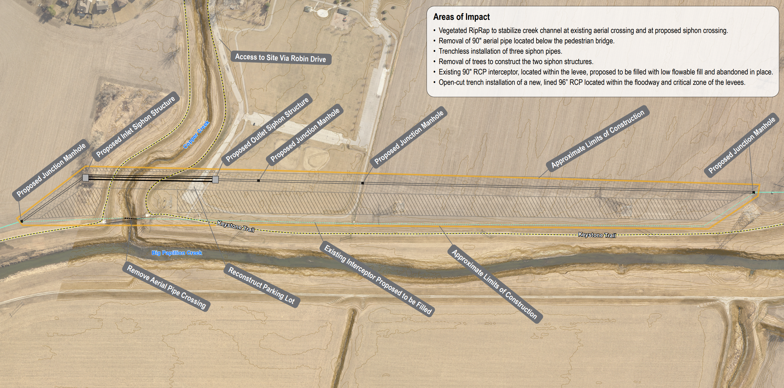
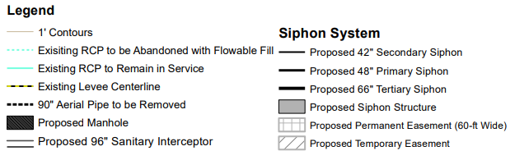
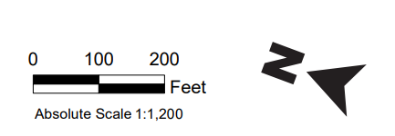
Potential Impacts Map

Slide 7
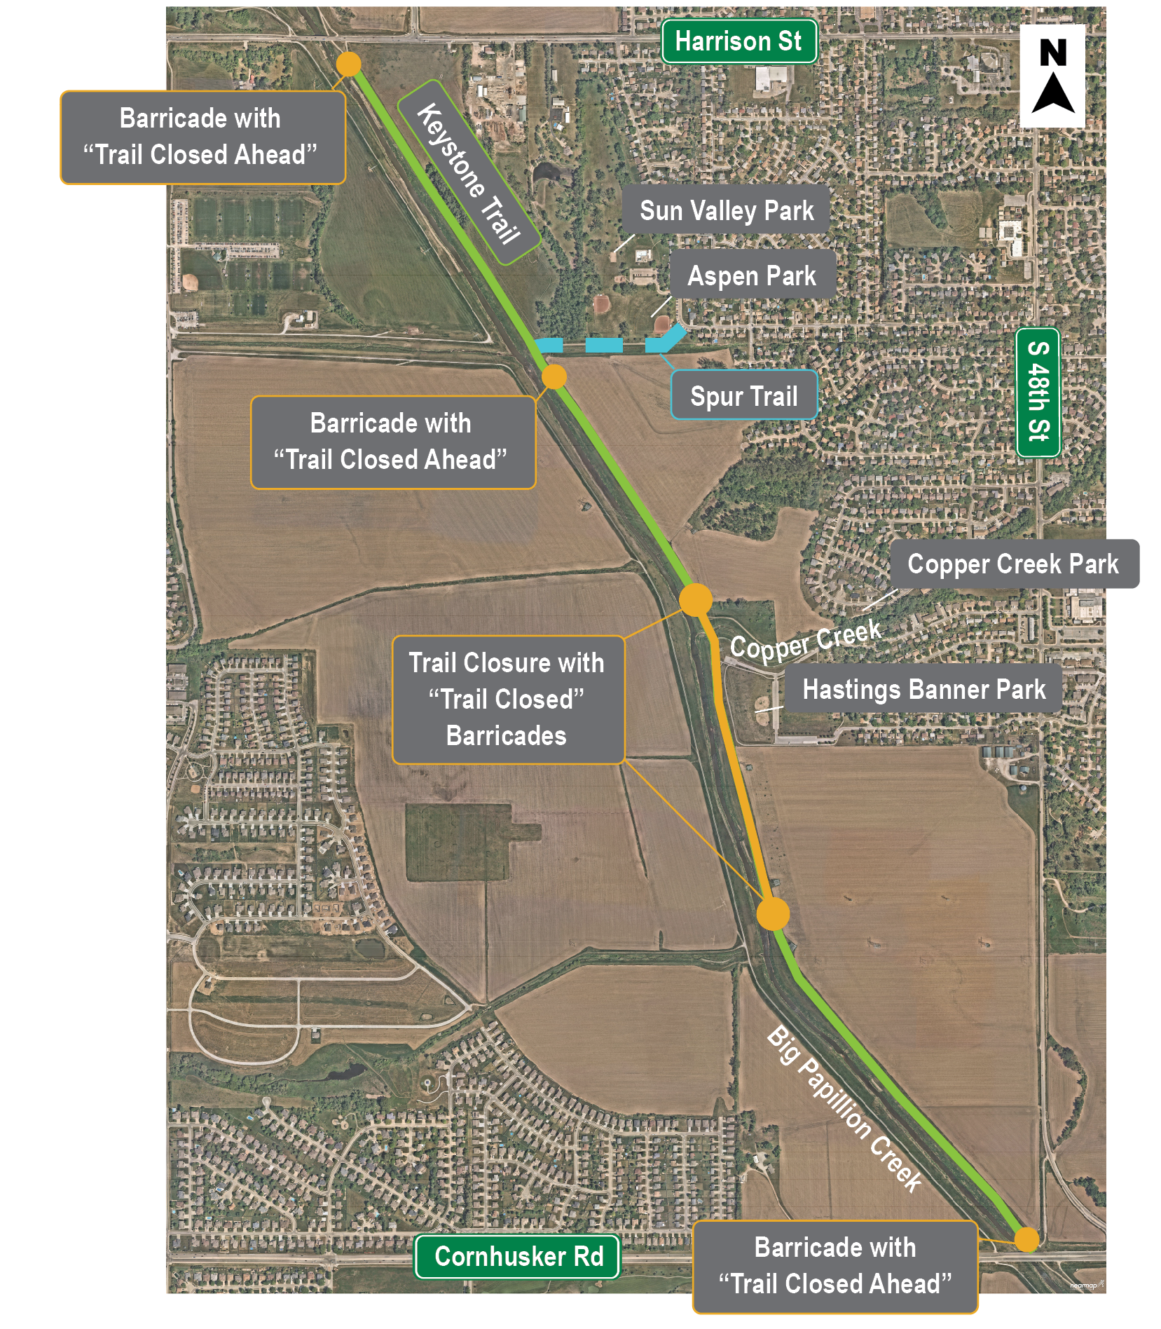
Pedestrian Trail Closure
Part of the Keystone Trail will be closed during the months of January, February and March of 2024.
“Trail Closed” and “Trail Closed Ahead” signs will be placed upstream and downstream of the work site on Keystone Trail. Also, pre-warning signs will be placed on Giles/Copper Creek connector trails entrances from local residential areas and the Bellevue Parks.

Slide 8
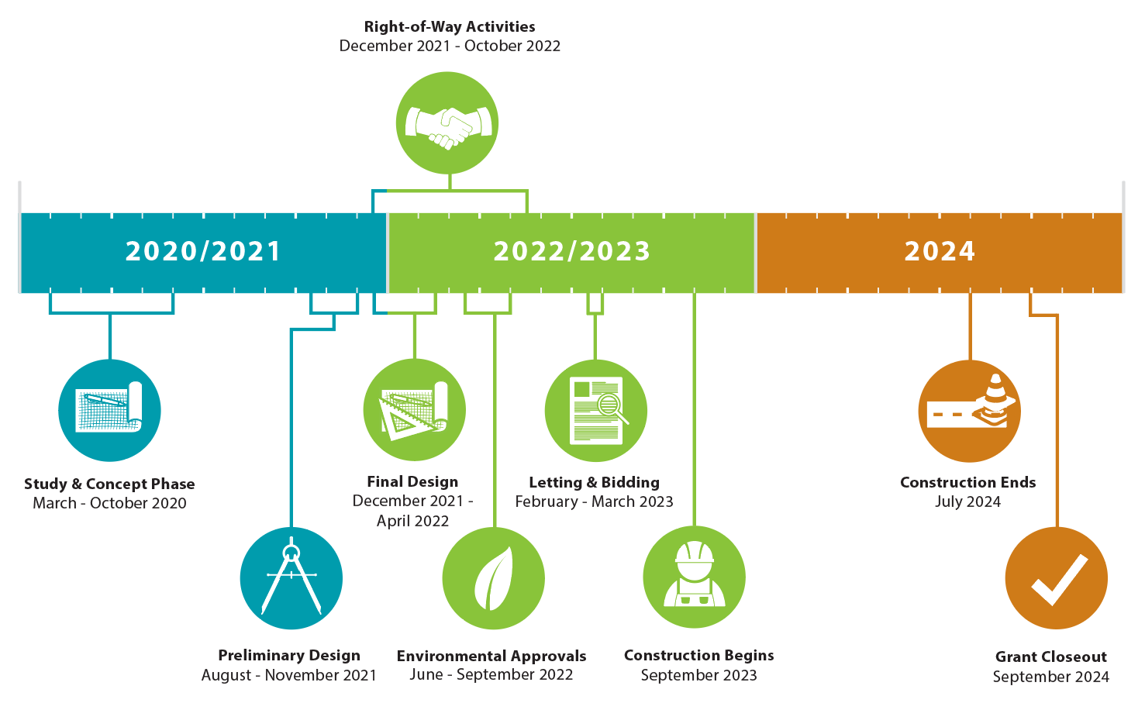
SCHEDULE overview

Slide 9
Comments
There are several opportunities to provide input or ask questions of the Project team. Comments are due by September 30, 2023.
Complete a comment form at today’s meeting
Send written comments to
Chris Driscoll, Project Manager, City of Omaha
1819 Farnam Street, Suite 604
Omaha NE 68183
402-444-5220
Or email: Christine.Driscoll@cityofomaha.org
For more information on this Project, to review materials from today, or to comment online, please visit KeepItCurrentOmaha.com.

Slide 10
Copper creek sewer interceptor relocation
Opw 53698
September 15, 2023

